Slide 1

CH 42010: PROCESS PLANT OPERATION & SAFETY
LTP: 3-0-0, CRD: 3
Lecture 3
Plant and Equipment Start Up & Shut Downs

Slide 2
START-UP & SHUT DOWN
START-UP is the initial procedure of a chemical plant that allows reaching the normal operating conditions.
Dry start-up of the empty equipment.
Start-up of the plant after some maintenance due to a partial shutdown.
SHUT DOWN is the final procedure of a chemical plant that shutdowns the production and takes the plant to the atmospheric conditions in order to inspect and maintain it.
Total or partial shutdown to perform ordinary maintenance – Planned Shut Down.
Critical, also known as Emergency Shut Down due to malfunction, trouble, fault, abnormal situation, accident.
More than 20% of accidents occur during the startup or shutdown procedures.
Several accidents, which occur during the normal working conditions of the plant, are caused by either thermal or mechanical stresses as a consequence of these operations.
Important during startup/shutdown procedures:
At the design stage, to identify and define all the services and dedicated units which are necessary to carry out those procedures
To train both control-room and field operators
To save time and money thanks to the optimization of the startup/shutdown procedures

Slide 3
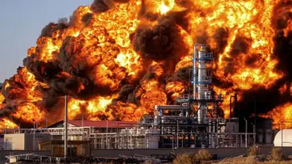
START-UP & SHUT DOWN PREPARATION
The hazards that are most frequently encountered during the startup/shutdown procedures are:
Mixing of air and hydrocarbons
Contact of water with hot oil
Freezing of residual water in equipment
Corrosive and poisonous liquids and gases
Thermal and mechanical stresses
These hazards can result in fires, explosions, destructive pressure surges, and other damages to the units, as well as injuries to personnel.
The complete plan for a startup and shutdown should include previous preparation of the process units together with piping, valves, instrumentation, utility lines, and storage vessels.
The startup and shutdown procedures must be written, formalized, agreed, and strictly followed. These are called Standard Operating Procedure (SOP).
The critical path (arrow diagram) method has been used in recent years for planning.
Source: Google Images

Slide 4
START-UP & SHUT DOWN PREPARATION
Start-up and shutdown procedures must incorporate several initial measures:
Preparing adequate operating, start-up, shutdown and maintenance procedures
Ensuring the operating team consists of workers who possess all the skills likely to be required
Adequate training of the operating team, supervisors, and trainers
Proper start-up planning
Securing all the stuff required
Developing adequate procedures for last-minute modifications
Developing individual tasks by members of the procedures team
Preparing a checklist for each phase of the start-up/shutdown procedure
Preliminary Preparations
Usually, commissioning operations are performed using available liquids and gases, such as air, nitrogen, steam, water, or oil. This may be problematic because process units are designed to work at nominal operating conditions.
Preliminary preparations are operations performed to prepare the process units to the start-up/shutdown procedure. The objectives are:
to test the equipment and fix potential problems.
to take preventive measures against performance deterioration.

Slide 5
PRELIMINARY PREPARATIONS FOR START-UP
A pre-start-up practise consists in the leak-testing, the most common technique is pressuring up the units with inert gas, with all vents and drains closed, and then monitor the rate of pressure loss.
When leaks are detected, bolts are tightened, if the leak persists, it may be necessary to depressurize the system and correct the fault. The test continues until no more leaks are detected.
Alternative techniques, involve hydrostatic testing of the column or pressuring it up with steam. Water makes leak-detection easier, but is more troublesome to use than nitrogen (hydrostatic loads problem).
Other techniques use an easily detectable tracer gas.
Another pre-start-up practise is solvent-testing. Its purpose is to run the unit with a solvent, a “safe” fluid, whose properties are close to those of the feed.
Select the solvent closer to the process fluid to have a more meaningful test.
Pre-test checks must be carried out to ensure that operating capacity, relief capacity of the equipment, together with safe working temperature, and internal supports are adequate for the test.
Following the test, the solvent must be removed. However, if the solvent is acceptable/consistent with the final product(s), the removal is not necessary.
Advantage: allows testing the reliability of instrumentation, alarms, trips, and emergency systems. It is often beneficial for operator training.

Slide 6
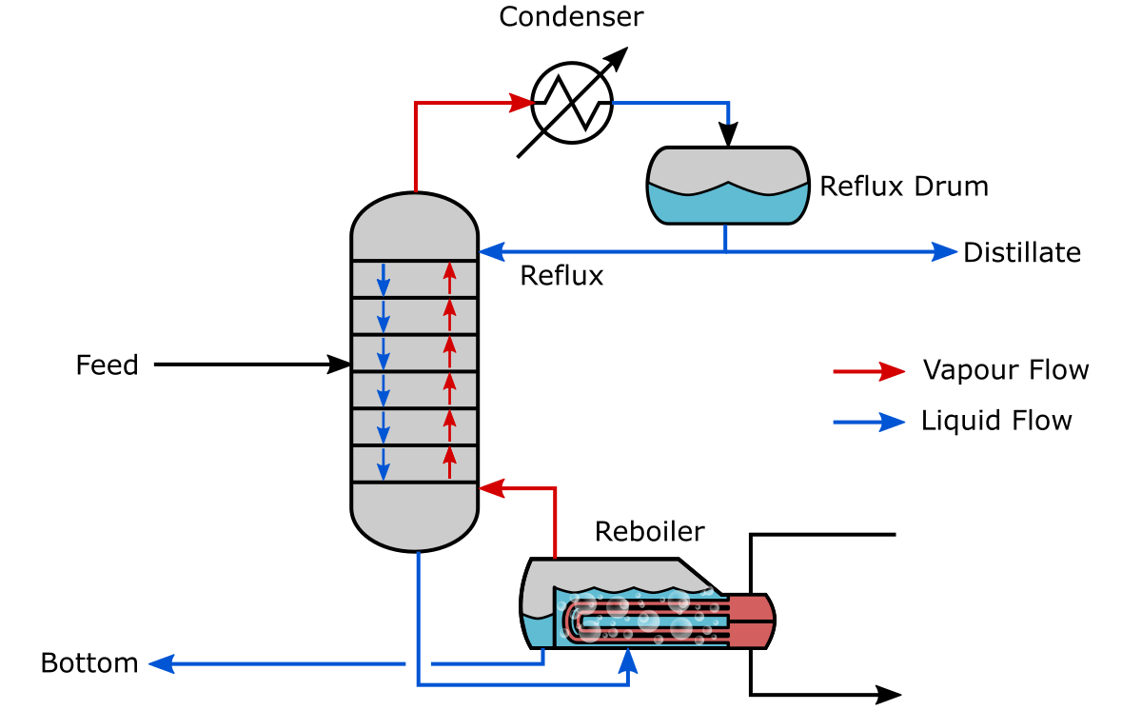
WHAT HAPPENS AT START-UP?
Before Startup, How do you assure there are no leaks?
Leak-testing / Solvent-testing
If yes, any Implications on design?
If no, go ahead…
Did you design in the Isolation valves?
Do you have a pressure gage installed?
What gas are you going to use?
Do you have adequate onsite storage for this gas?
1.72 Mpa
17 bar
Air was in the columns when it was charged with a fuel
Fuel was then made hot in reboiler.
Fires take place inside the columns-Overheating the steel, welds & melting gaskets.
How to you eliminate air from a vessel and then fill it to start up?
N₂? Do you have a storage tank with that much N₂?
Are lines in place? What Pressure?
Sufficient Pressure Relief Valves – are they set properly, are they the correct size?
Other Options ?
Distillation Column
Source: Google Images

Slide 7
WHAT HAPPENS AT START-UP?
Before Startup, How do you assure there are no leaks?
Leak-testing / Solvent-testing
If yes, any Implications on design?
If no, go ahead…
Did you design in the Isolation valves?
Do you have a pressure gage installed?
What gas are you going to use?
Do you have adequate onsite storage for this gas?
Reflux
1.72 Mpa
17 bar
Reboiler
Start-Up Sequence
Add mix to B1 (initial charge)
Run at infinite recycle to warm up equipment
Did you design valving to run at infinite recycle?
Did you add a storage tank for this mixture?
Add mix to B2
Run at infinite recycle to warm up equipment
Add mix to B3
Run at infinite recycle to warm up equipment
Add mix to B4
Run at infinite recycle to warm up equipment
Start Feed
Set boil-up ratio and reflux ratio in B1, B2, B3 and B4 one at a time
Open up the connection valves so that the feed can be separated from B1 to B3 and B4.
Initially product purity is not to specifications.
Initial materials are reprocessed
Do you have a tank that can handle all this off spec material?
Would surge tanks between distillation columns be useful for these initial surging conditions?

Slide 8

SHUTDOWN PROCEDURES
Cooling
Cooling is performed at the initial phase of shutdown.
A possible way to cool the process units is to wash them.
In addition, units are also washed for one of the following reasons:
1. To remove solids and corrosive products
2. To uncover leaks and check the pumping operation
3. To dissolve undesirable materials
4. To wet column internals
5. To remove water
A water wash-up is effective for the first four reasons (1-4)
A chemical wash-up is used for the last reason (5)
Washing may help against resisting debris, so it is recommended a water velocity of about 3.6 m/s.
Water washing should not be performed unless the unit is sufficiently cool, i.e. cooler than 90 °C.
The shutdown procedures usually include the following operations:
Cooling
Pumping out
Residuals removal
Blinding and opening
Inspection for entering
Source: Google Images

Slide 9
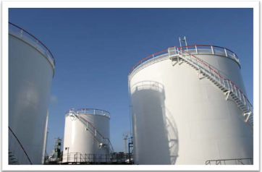
SHUTDOWN PROCEDURES
Pumping Out
The liquid materials, once cooled to the assigned temperature, should be pumped out of the units.
Materials should be routed to some storage devices (e.g., vessels, tanks, pools) according to their composition/purity, by using dedicated lines/pipes.
Inert gases or steam should fill in the unit during the pump out operation for two reasons:
To prevent leakages of air into the unit (and possibly enter the explosivity region)
To prevent the collapse of those process units that were not designed to withstand vacuum conditions.
The shutdown procedures usually include the following operations:
Cooling
Pumping out
Residuals removal
Blinding and opening
Inspection for entering
Source: Google Images

Slide 10
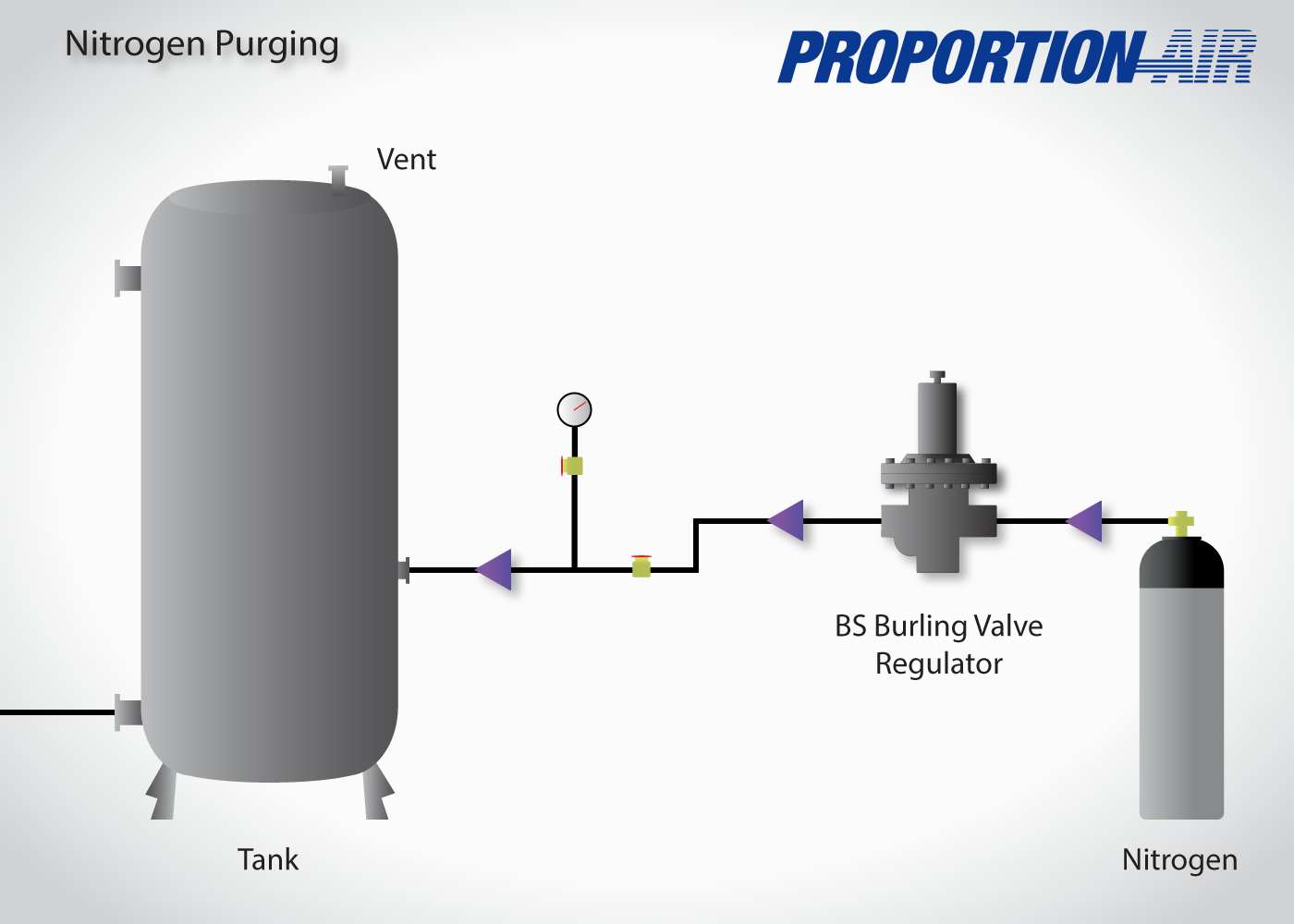
SHUTDOWN PROCEDURES
Purging to Remove Residuals
When the process unit separates combustible or hazardous materials, they are usually purged with an inert gas prior to start-up, to remove air. Then the process unit may be purged with the process gas to remove the inert gas.
The reverse steps are performed at shutdown.
The process unit type determines the appropriate purging substance (e.g., steam for distillation/coking units; inert gas for units with catalysts).
N₂ is the most common inert gas; steam and CO₂ are also used. At shutdown, it is worth purging the column with nitrogen prior to steaming, to eliminate combustibles.
Purging often requires installation of special purge lines or purge connections. One rule is to size them to deliver a purge gas volume four times the volume of equipment to be purged over 10 hours.
Isolation valves should be opened and remain open during the purge period to avoid trapping of liquids or undesirable components.
In case of very cold working conditions the use of steam or water for purging and washing purposes during shutdown, can introduce serious hazards.
The shutdown procedures usually include the following operations:
Cooling
Pumping out
Residuals removal
Blinding and opening
Inspection for entering
Source: Google Images

Slide 11
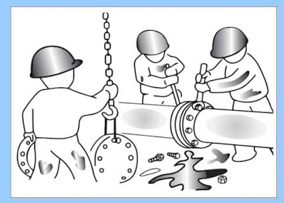
SHUTDOWN PROCEDURES
Blinding and Opening
Shutdown blinds and slip plates are usually installed in all lines which leave or enter the process units in order to eliminate leakage of material into the column when air is introduced.
Extreme caution must be exercised when flanges for blinding or opening are operative. Flanges should be opened slowly and valves should not be closed until the unit is empty.
Blinds should be properly tagged, a checklist of them should be made and the sequence of blinding must be planned and defined in the operating procedure.
It is mandatory to check the lines prior to start the sequence.
The pressure, temperature, and material specifications of each blind should be checked to avoid any inconsistencies with the process unit or the input/output lines.
The shutdown procedures usually include the following operations:
Cooling
Pumping out
Residuals removal
Blinding and opening
Inspection for entering
Source: Google Images

Slide 12
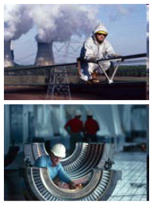

SHUTDOWN PROCEDURES
Inspection for Entering
Precautions recommended and required by law before entering the unit for inspection:
The officer responsible for safety, before allowing the personal to enter the process unit must:
Approve the work procedures and emergency plans
Check that the process unit is safe
Ensure that work will be performed under qualified supervision
Then can issue a written permit to inspect the process unit
The equipment must be isolated from any chemicals or service lines (using only valves may not be satisfactory as they can leak).
Any lines connected to the units must be blinded or fully disconnected.
It is a good practice to post a “danger: workers inside the unit” notice.
Any electrical device or any radiation sources should be removed.
The shutdown procedures usually include the following operations:
Cooling
Pumping out
Residuals removal
Blinding and opening
Inspection for entering
Source: Google Images

Slide 13
SHUTDOWN PROCEDURES
Inspection for Entering
Any materials (e.g., small amounts of solvent for weld-testing) should be critically examined. Their evaporation may generate an hazardous atmosphere inside.
The atmosphere inside the unit must be analyzed to contain 19.5 to 23.5 % of oxygen. The test should be repeated at regular intervals.
The appropriate Individual Protection Devices must be worn inside the unit at all time to avoid injury.
Adequate and reliable lighting must be provided inside the unit.
A proper communication system must be devised.
The shutdown procedures usually include the following operations:
Cooling
Pumping out
Residuals removal
Blinding and opening
Inspection for entering
Source: Google Images

Slide 14
PRESSURIZATION & DE-PRESSURIZATION
These operations are performed during commissioning, start-up, and shutdown. They are used in order to:
Reach the atmospheric or operative unit pressure
Remove air or inert gas
Prepare the unit for entry by personnel
Pressurization and depressurization should be carried out at a controlled rate, sufficiently slow to avoid unit damages and breakdowns.
Location of relief valves, bursting disks, and major vents should be carefully reviewed. Usually, these should be at the top of super-atmospheric units and at the bottom of vacuum units.
Excessive vapor flow rates may cause flooding and gas lifting of the liquid, resulting in a liquid discharge into the relief valve (champagne bottle effect).
Pressurization and depressurization should be performed in dry-units, so it is recommended to drain liquid before these operations are carried out.
When the equipment is located between intermediate stages of a compression train, the effect of compressor surging on unit internals should be considered. Bypassing the column during compressor startup often overcomes this problem.

